Slide 1
Let’s Make Laundry Less of a Chore
Navigate your campus laundry room with ease

Slide 2
Your Laundry Program
Easy Wash
Simple Dry
Requesting Service
Fun Activities and Education
Connect with Us

Slide 4
Easy Wash
Add detergent to detergent drawer or toss a laundry pod in with your clothing
Load washer (DO NOT overload: leave about five inches of space at the top of the machine)
Select your cycle
Swipe or tap for payment (if applicable)
Cold water cleans effectively and saves energy

Slide 5
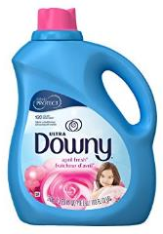
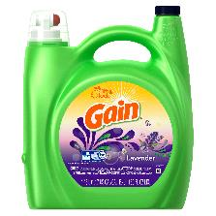
Let’s Talk About Soap
What kind of soap should I use?
Laundry Pods
(use in washer)
Use one pod per wash load. Place the pod inside the wash tub before adding your clothes.
Fabric Softeners (optional) (use in washer)
help protect your fabrics in the wash from pilling and fraying. They add a layer of softness to your fabrics.
Liquid Detergent
(use in washer)
Always check the dose recommendation on your detergent package. 2 tablespoons of detergent is enough for a medium size load.
Dryer Sheets (use in dryer)
Fabric rubbing together in the dryer causes static. Dryer sheets fight static in the dryer.

Slide 6
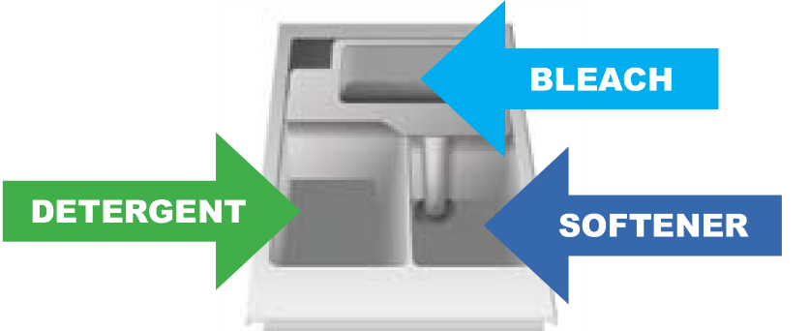
Let’s Talk About Soap
How much soap should I use?
Save your soap, use only two tablespoons of High Efficiency (HE) detergent or one laundry pod
Where do I put the soap?
Place liquid detergent in the detergent drawer
Place pods in the wash tub with your clothing

Slide 7
Do Not Overload
Your clothes needs enough room to tumble. Apply the palm trick to avoid overloading!
The Palm Trick Just place your hand into the drum, and if your hand fits between your clothes and the wall of the drum, then you have the perfect load size. It’s as easy as that!

Slide 8
Washer Hints
Dryer Safety
Do not overload – leave 5” of space at the top of the machine
Use the recommended amount of detergent
If using pods, place them in the tub with your clothing
Always empty your pockets before placing clothing in the washer

Slide 10
Simple Dry
Clean lint screen for maximum air flow
Select temperature
Select cycle
Swipe or tap for payment (if applicable)
Hint: 1 wash load = 1 dry load

Slide 11
Dryer Hints
Dryer Safety
Do not dry wool, rubber, or plastic
Be careful; the hot setting may cause shrinkage
Do not overload; overloading can get expensive and even dangerous
Clean the dryer lint filter before and after each load

Slide 13
3 Easy Ways to Request Service
Please do not assume someone else has reported the issue.
Report all issues using one of the methods listed above.

Slide 14
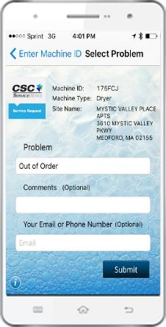
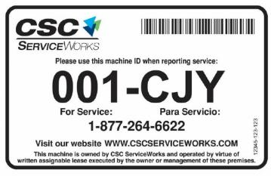
Use the app to request service
Requesting service is easier than ever!
1. Download the app on your smartphone.
2. Scan barcode (located on license plate on the front of the machine).
3. Select the problem from a dropdown list and hit submit.

Slide 16
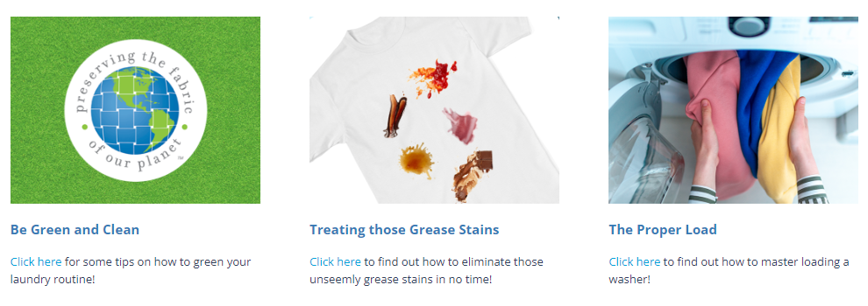
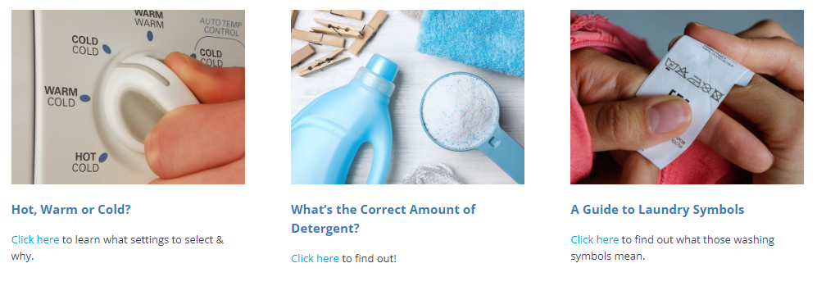
CSC Academic Website
https://www.cscswacademic.com/campus-resources/campus-resources-for-students/

Slide 17
Connect with: CSC ServiceWorks Academic

Slide 18
THANK YOU
FOR YOUR TIME

