Slide 1



Let’s Make Laundry Less
of a Chore
Navigate your campus
laundry room with ease

Slide 2
Your Laundry Program
  Easy Wash
  Simple Dry
  CSCPay Mobile
  Requesting Service
  Fun Activities and Education
  Connect with Us

Slide 4


Easy Wash
Add detergent to detergent drawer or toss a laundry pod in with your clothing
Load washer (DO NOT overload: leave about five inches of space at the top of the machine)
Select your cycle
Swipe or tap the card reader on the
machine with the CSCPay App, credit card, or campus card and press start.
Cold water cleans effectively and saves energy

Slide 5




Let’s Talk About Soap
What kind of soap should I use?
Laundry Pods
(use in washer)
Use one pod per wash load. Place the pod inside the wash tub before adding your clothes.
Fabric Softeners (optional)
(use in washer)
help protect your fabrics in the wash from pilling and fraying. They add a layer of softness to your fabrics.
Liquid Detergent
(use in washer)
Always check the dose recommendation on your detergent package.
2 tablespoons of detergent is enough
for a medium size load.
Dryer Sheets
(use in dryer)
Fabric rubbing together in the dryer causes static. Dryer sheets fight static in the dryer.

Slide 6

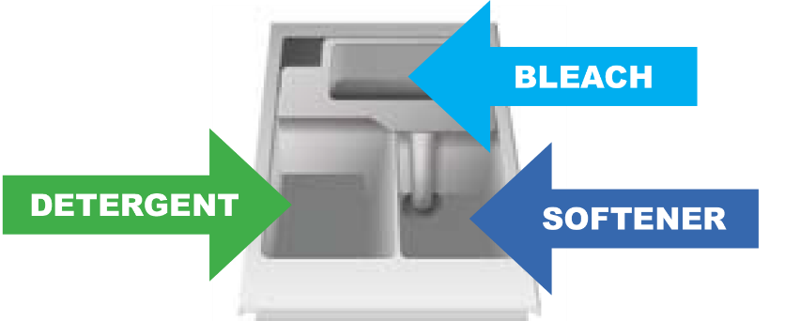
Let’s Talk About Soap
How much soap should I use?
Save your soap, use only two tablespoons of High Efficiency (HE) detergent or one laundry pod
Where do I put the soap?
Place liquid detergent in the detergent drawer
Place pods in the wash tub with your clothing

Slide 7

Do Not Overload
Your clothes needs enough room to tumble. Apply the palm trick to avoid overloading!
The Palm Trick Just place your hand into the drum, and if your hand fits between your clothes and the wall of the drum, then you have the perfect load size. It’s as easy as that!

Slide 8

Washer Hints
Dryer Safety
Do not overload – leave 5” of space at the top of the machine
Use the recommended amount of detergent
If using pods, place them in the tub with your clothing
Always empty your pockets before placing clothing in the washer

Slide 10

Simple Dry
Clean lint screen for maximum air flow
Select temperature
Select cycle
Swipe or tap the card reader on the
machine with the CSCPay App, credit card,
or campus card and press start.
Hint: 1 wash load = 1 dry load

Slide 11
Dryer Hints
Dryer Safety
Do not dry wool, rubber, or plastic
Be careful; the hot setting may cause shrinkage
Do not overload; overloading can get expensive and even dangerous
Clean the dryer lint filter before and after each load

Slide 12

CSCPAY
MOBILE

Slide 13

Introducing the CSCPay Mobile App on Vimeo

Slide 14
The Home Screen
Account Summary
Shows your registered email and amount in your account (funds will be automatically added when you create your account)
Room Snapshot
Quick look at how many machines are available in your laundry room.
Scan Start
Touch this button in order to scan the machine sticker to activate the machine. Once the washer or dryer beeps, push the start button on the machines control panel.
Manual Entry
You can also push this button to manually enter in the machine number. Once you enter the number, the washer or dryer will beep then just push start on the machines control panel.

Slide 15
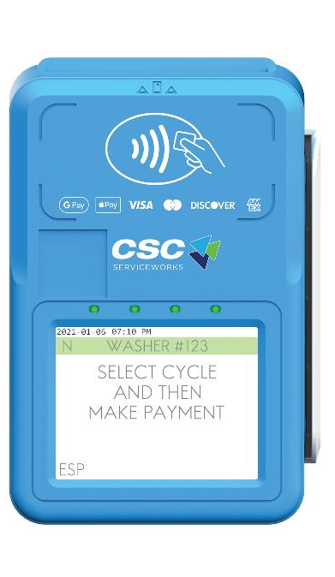


How to Pay for Laundry
1. Load Laundry: Place laundry into the machine and select cycle.
2. Make a Payment: Use the CSCPay Mobile app, campus card, or credit card. Scan, tap, or insert your payment and follow the instructions on the card reader display.
3. Start the Machine: If you used the CSCPay Mobile app to pay, you may opt to receive a notification when your laundry cycle is complete.

Slide 16
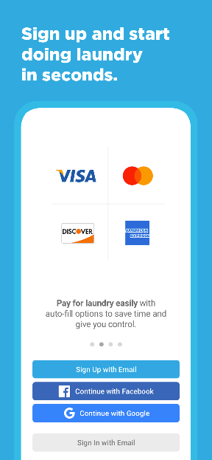
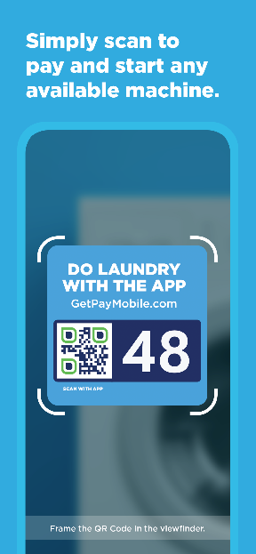
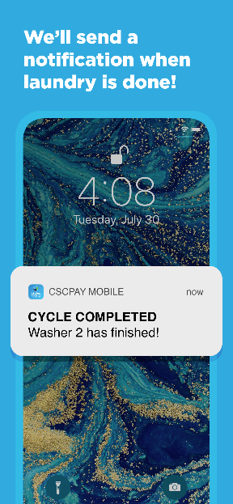
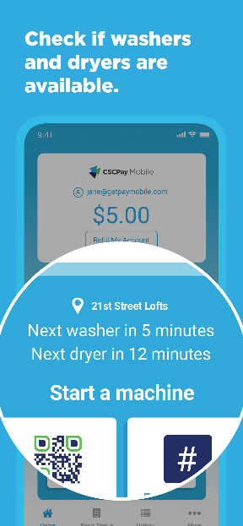
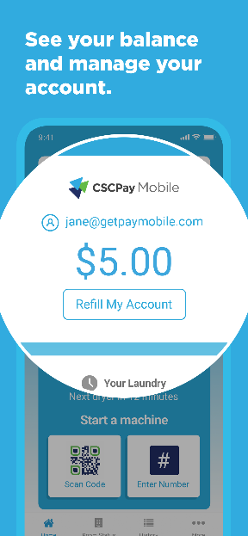
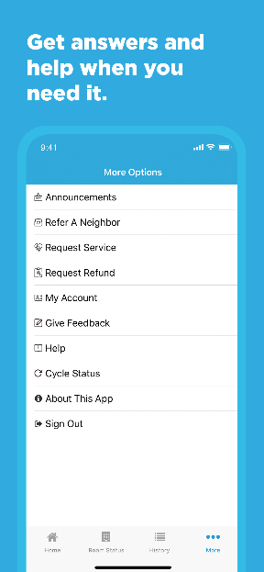
CSCPay Mobile App
Making Laundry Easy and Efficient

Slide 17
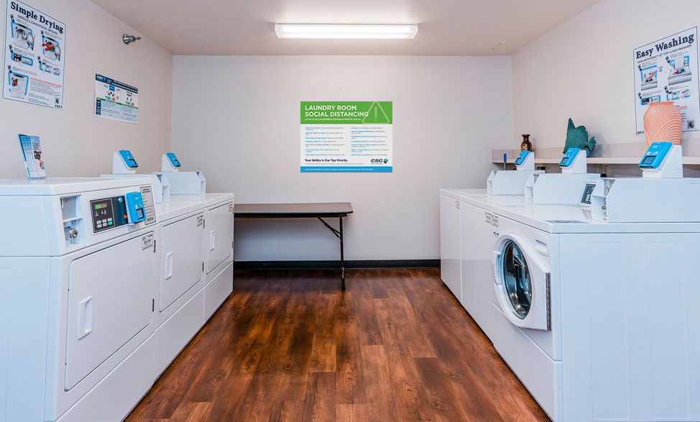


Helpful Hint
Downloading the app in the laundry room connects to your location quicker which allows the app to run more effectively.

Slide 18

Let’s get started!
Scan the QR Code on the right and follow the link to download CSCPay today!

Slide 19
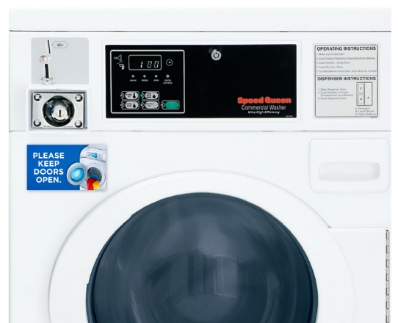
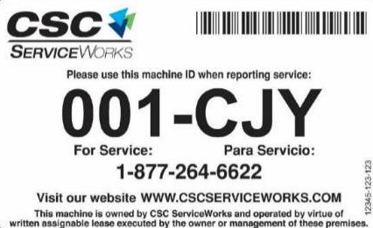

Use the app to request service
Requesting service is easier than ever!
2. Scan barcode
(located on license plate on the front of the machine).
3. Select the problem from a dropdown list and hit submit.
1. Download the CSCPay Mobile app on your smartphone.
Helpful Hint
Do not assume someone else has reported the issue. Report all issues using one of the methods listed above.

Slide 21

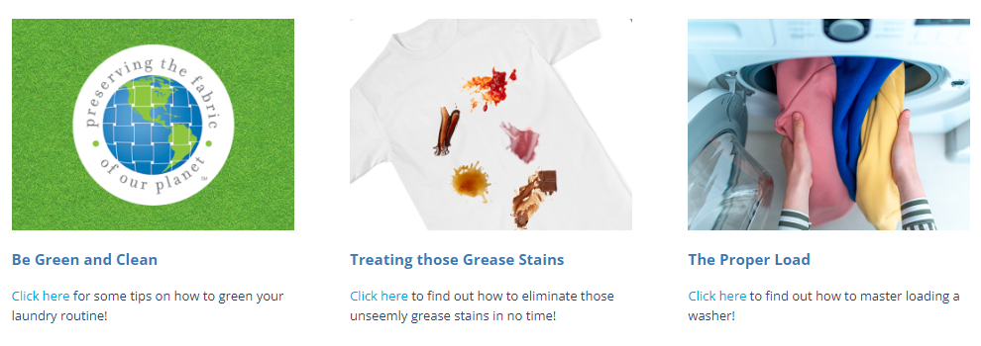
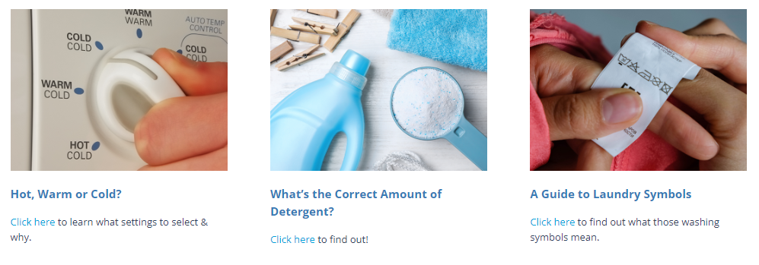
CSC Academic Website
https://www.cscswacademic.com/campus-resources/campus-resources-for-students/

Slide 22





  Connect with:
  CSC ServiceWorks Academic

Slide 23
THANK YOU
FOR YOUR TIME

