Slide 1



Let’s Make Laundry Less
of a Chore
Navigate your campus
laundry room with ease

Slide 2
Your Laundry Program
  Easy Wash
  Simple Dry
  CSC GO
  Requesting Service
  Fun Activities and Education
  Connect with Us

Slide 4


Easy Wash
Add detergent to detergent drawer or toss a laundry pod in with your clothing
Load washer (DO NOT overload: leave about five inches of space at the top of the machine)
Select your cycle
Swipe or tap for payment (if applicable)
Cold water cleans effectively and saves energy

Slide 5

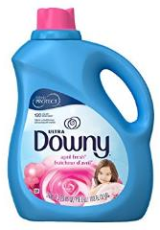
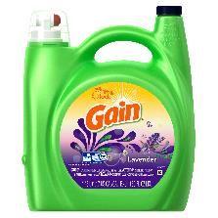

Let’s Talk About Soap
What kind of soap should I use?
Laundry Pods
(use in washer)
Use one pod per wash load. Place the pod inside the wash tub before adding your clothes.
Fabric Softeners (optional)
(use in washer)
help protect your fabrics in the wash from pilling and fraying. They add a layer of softness to your fabrics.
Liquid Detergent
(use in washer)
Always check the dose recommendation on your detergent package.
2 tablespoons of detergent is enough
for a medium size load.
Dryer Sheets
(use in dryer)
Fabric rubbing together in the dryer causes static. Dryer sheets fight static in the dryer.

Slide 6

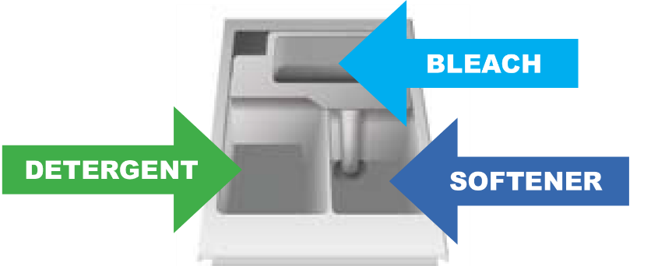
Let’s Talk About Soap
How much soap should I use?
Save your soap, use only two tablespoons of High Efficiency (HE) detergent or one laundry pod
Where do I put the soap?
Place liquid detergent in the detergent drawer
Place pods in the wash tub with your clothing

Slide 7

Do Not Overload
Your clothes needs enough room to tumble. Apply the palm trick to avoid overloading!
The Palm Trick Just place your hand into the drum, and if your hand fits between your clothes and the wall of the drum, then you have the perfect load size. It’s as easy as that!

Slide 8

Washer Hints
Dryer Safety
Do not overload – leave 5” of space at the top of the machine
Use the recommended amount of detergent
If using pods, place them in the tub with your clothing
Always empty your pockets before placing clothing in the washer

Slide 10

Simple Dry
Clean lint screen for maximum air flow
Select temperature
Select cycle
Swipe or tap for payment (if applicable)
Hint: 1 wash load = 1 dry load

Slide 11
Dryer Hints
Dryer Safety
Do not dry wool, rubber, or plastic
Be careful; the hot setting may cause shrinkage
Do not overload; overloading can get expensive and even dangerous
Clean the dryer lint filter before and after each load

Slide 12

CSC GO Mobile

Slide 13
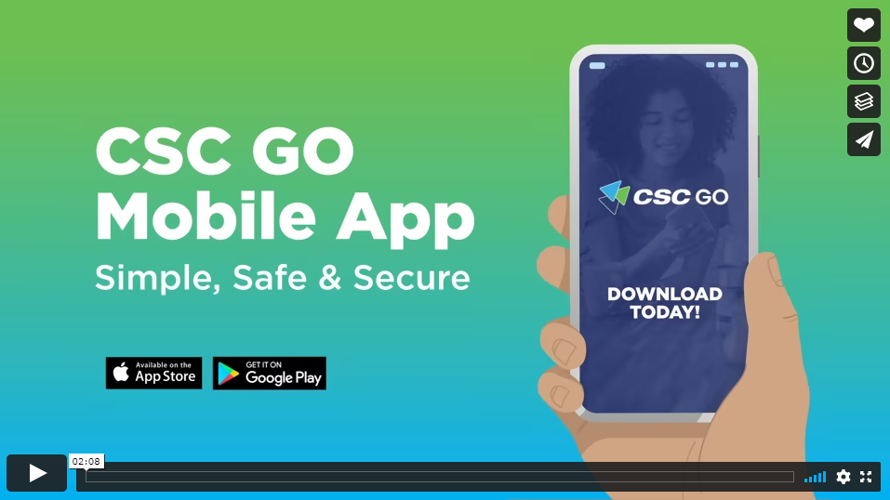
Introducing the CSC GO Mobile App on Vimeo
Notes:
Let me show you a quick 1 minute video.

Slide 14
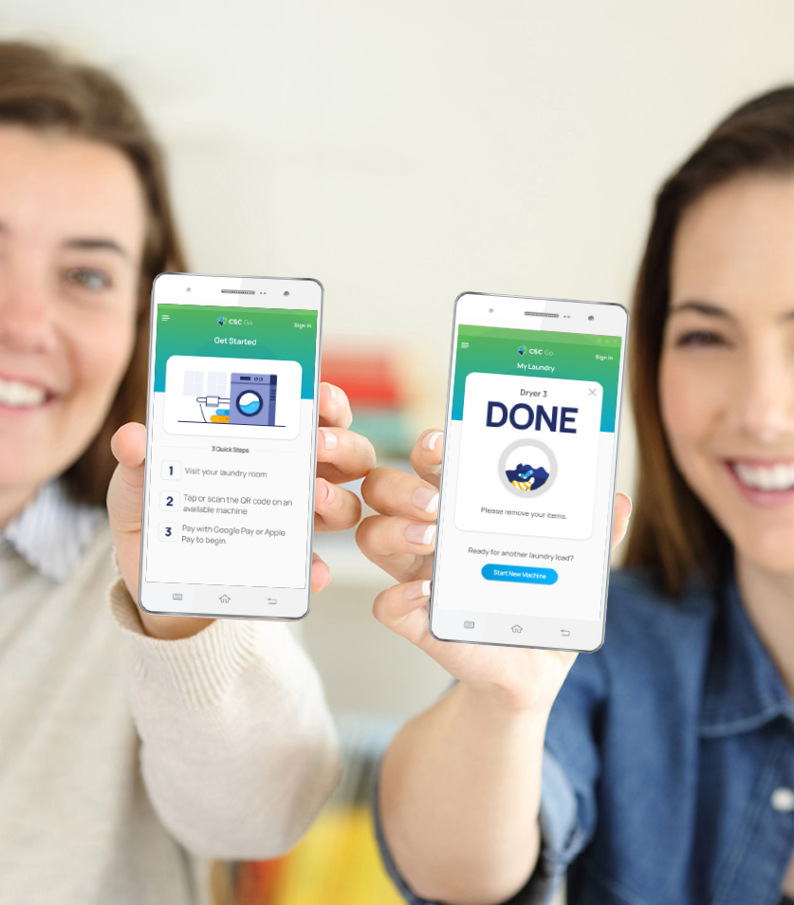
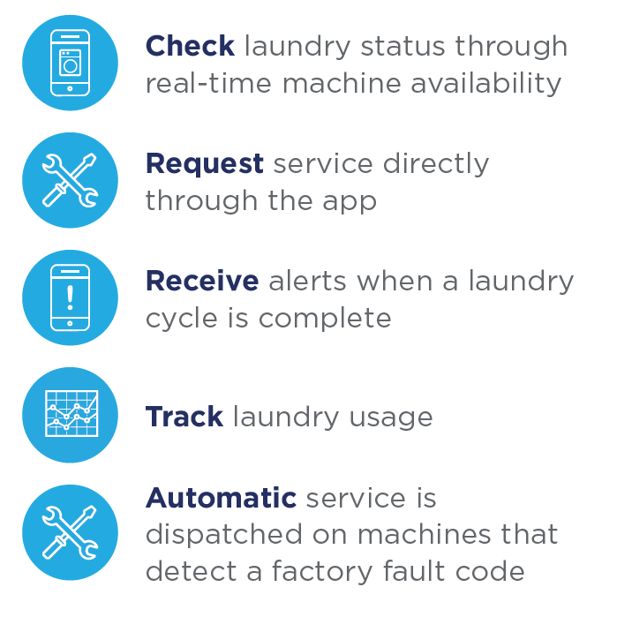


Slide 15
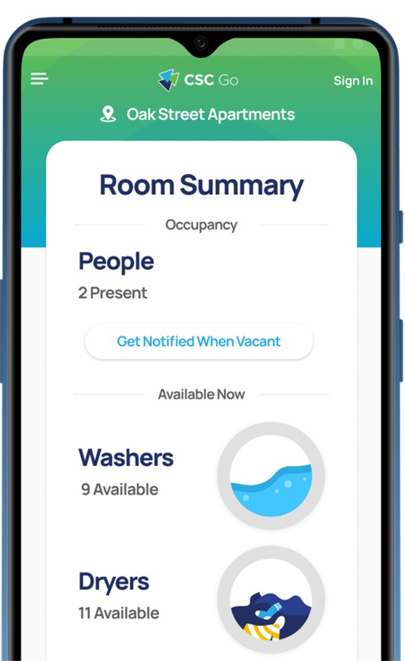
The Home Screen
Account Summary
Provides account info such as your registered email.
Room Snapshot
Quick look at how many machines are available in your laundry room.
Scan Start
Touch this button in order to scan the machine sticker to activate the machine. Once the washer or dryer beeps, push the start button on the machines control panel.
Manual Entry
You can also push this button to manually enter in the machine number. Once you enter the number, the washer or dryer will beep then just push start on the machines control panel.

Slide 16
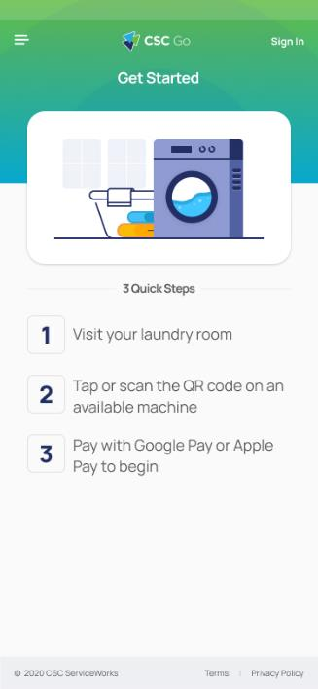
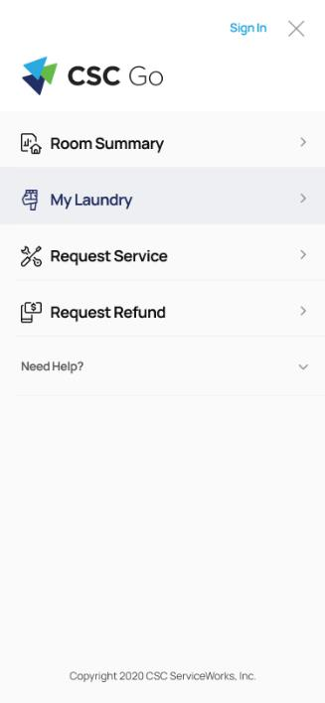
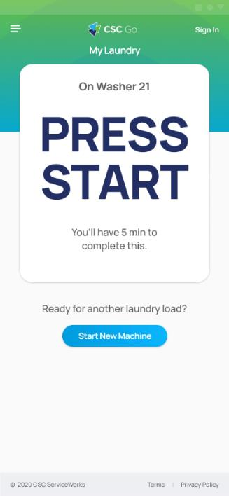
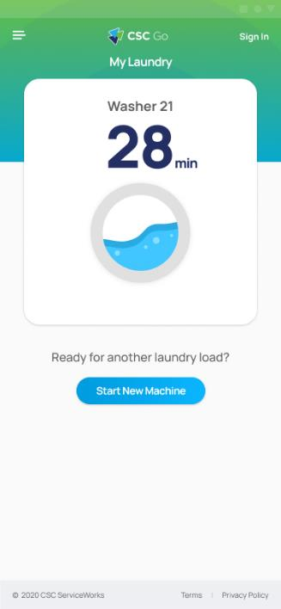
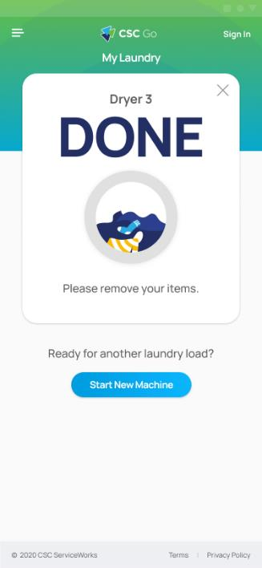
CSC GO User Interface

Slide 17

How it Works
MOMENTARILY TAP the machine sticker with your NFC capable smartphone, or SCAN a machine code with your smartphone camera or QR code app.
LOAD the machine.
SELECT cycle and press start.

Slide 18


Helpful Hint
Downloading the app in the laundry room connects to your location quicker which allows the app to run more effectively.

Slide 19





Let’s get started!
Scan the QR Code on the
right and follow the link to
download CSC GO today!
Know when laundry is done.
Earn rewards.

Slide 20
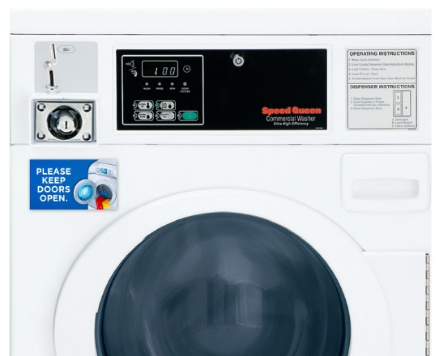
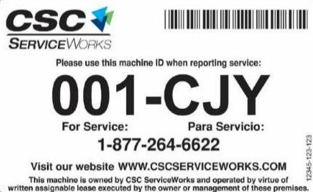

Use the app to request service
Requesting service is easier than ever!
2. Scan barcode
(located on license plate on the front of the machine).
3. Select the problem from a dropdown list and hit submit.
1. Download the CSC GO app on your smartphone.
Helpful Hint
Do not assume someone else has reported the issue. Report all issues using one of the methods listed above.

Slide 22

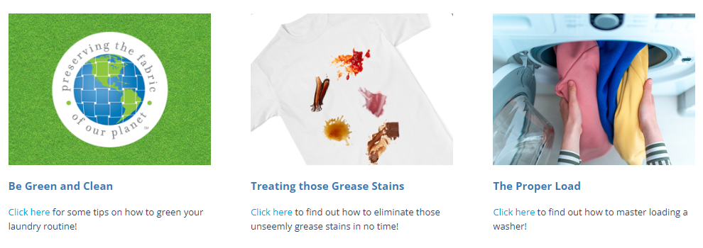
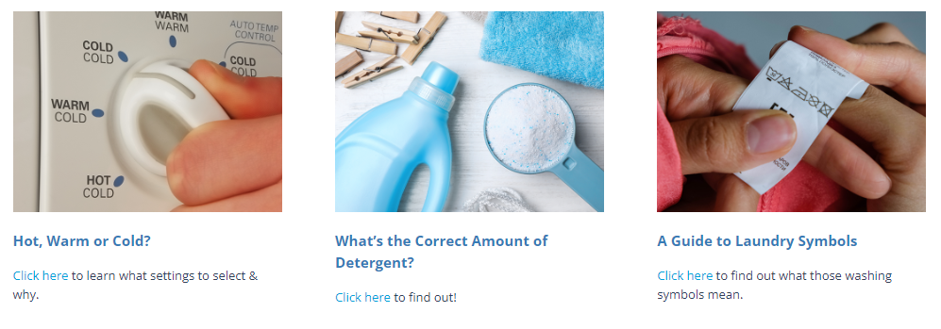
CSC Academic Website
https://www.cscswacademic.com/campus-resources/campus-resources-for-students/

Slide 23





  Connect with:
  CSC ServiceWorks Academic

